Slide 1

Does globalization necessitate free trade?
Are there any other viable alternatives?
Notes:
Free Trade is a system of trade policy that allow traders to trade across national boundaries without interference from respective governments.
By signing free trade agreements two (or more) countries which want to apply a free trade policy between them, they create a free trade area.
E.G :
EU (..)
European Free Trade Area (4)
Central European Free Trade Agreement (9)
Free trade implies the following features :
Trade of goods without taxes (including tariffs) or other trade barriers (e.g., quotas on imports or subsidies for producers)
Trade in services without taxes or other trade barriers
The absence of "trade-distorting" policies (such as taxes, subsidies, regulations, or laws) that give some firms, households, or factors of production an advantage over others
Free access to markets
Free access to market information
Inability of firms to distort markets through government-imposed monopoly or oligopoly power
The free movement of labor between and within countries
The free movement of capital between and within countries

Slide 2
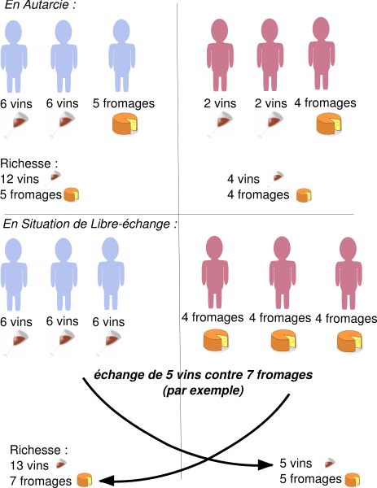
Benefits coming from free trade policy
The Law of
Comparative Advantage
Notes:
Possible in a free trade situation :
Two can both gain from trade if they have different relative costs for producing the same goods.
Event if the country is more efficient in the productions of all goods, it can still gain by trading with a less-efficient country, as long as they have different relative efficiencies.
Tl;fr
Every country specializes in the good they the more efficient (relative to the other country) and they get the other good by trading
Fear :
Some countries, rich (monetarily) enough, on buy to other country and sell nothing

Slide 3

An alternative when things go wrong : Protectionism
Notes:
Protectionism is the economy policy of restraining trade between states through methods suc has tariffs on imported good, restrictive quotas and a variety of other government regulations designed to discourage imports and prevent foreign take-over of domestic market and companies.
The idea is to protect from country that can destroy country’s economy by selling too many goods at a price the country producers can’t compete.
Or by limitate goods sold by quotas in order to keep a suficient amount of goods for the country to goes well.

