Slide 1


MySpace
Rise & Fall

Slide 2
Historic part
Social NetWork
Founded by Tom Anderson & Chris DeWolfe in August 2003
Based in United States
Bought in July 2005 by Rupert Murdoch Group
Official version appeared in France at the beginning of 2007

Slide 3
Web Site Description
Profile
Add photos and pictures
Chat rooms
Upload MP3 streams
Groups
Games
Classmates research

Slide 4
Expansion and Rise (1)
Fast evolution and development
Fast increase of users
Popularity
Fashionable effect
230 billions of users December 2008

Slide 5
Expansion and Rise (2)
Musical springboard
Official pages of famous musicians

Slide 6
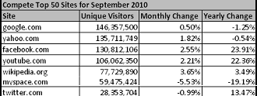
Turning Point :
Peak of monthly visitors has fallen down to 3.3 M unique visitor
In 2003, there was a peak of 100 M

Slide 7
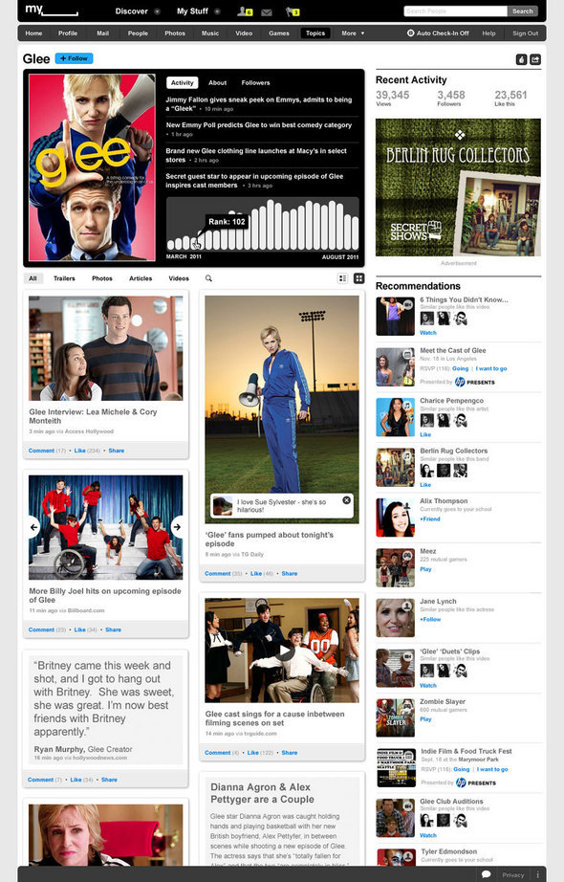
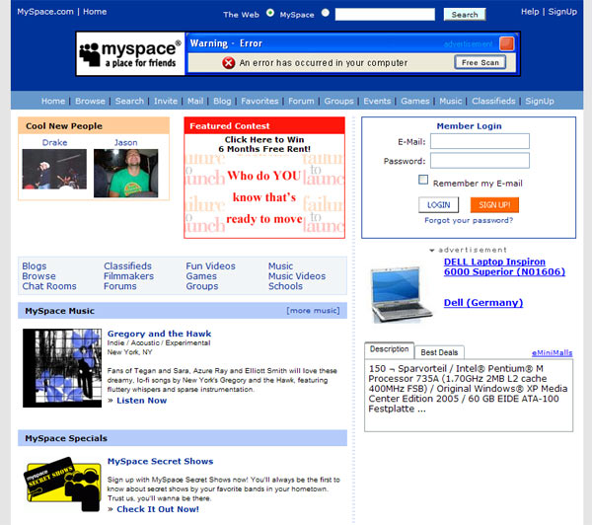
Trying to stay alive

Slide 8
Surrender
Facebook vs MySpace
500 M vs 122 M
Partnership with facebook
Able to synchronize MySpace’s activities on Facebook’s profile.
Facebook Connect
New roadmap
A new beta site launch in late November

Slide 9
MySpace’s future
Site based around music and content marketing
Recommandations in a Facebook-like manner
Pressure to develop a sustainable business model
Target 13-35 years old people

