Slide 1


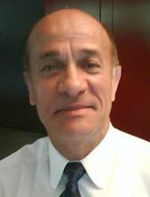
Roland P. Didier
International Senior SD consultant
20+ years experience in International environments for Sales administration and Logistics.
13 years experience as a consultant
NESTLE France (European global roll-out)
  Functional and organizational requirements.analysis.
  Learning & training Globe project best practices solution.
  User support, incident management, coordination with European competence center..
  Project management : Product allocation functional enhancements. Set up of triangular inter company flows, On-time delivery reporting.
ALM-Maquet (Information system extension to French market branch)
  Sales and logistic processes analysis. Business requirements analysis.
  Gap and adequacy analysis between legacy and German mother company.
  Decisional role concerning structural and functional choices.
  User trainings.
VETROTEX-Saint Gobain (International SAP implementation and roll-out project)
  Pilot go-live of a production plant in Mexico (sales administration and logistics).
  Set-up of a logistic warehouse in North Carolina (USA).
  Leading business process review workshops and user trainings.
  Business process decisional choices.
Project coordination and team management.
  Consulting
  Scope preparation , business requirements analysis.
Process analysis, configuration.
Expertise Applicative : SAP SD MM ECC6
Food industry
Metalurgy
Connectics
Car equipment manufacturing
Plastic industry

